Slide 1

Network Intrusion Detection System
By:
U.Rohith(9920004138)
P.Lakshmi Chaitanya(9920004261)
U.Anil Kumar(9920004263)
K Paramesh(9920004808)

Slide 2
Abstract
Network intrusion detection technology plays an important role in maintaining network security, the main work is to continuously detect the current network status, through the detection of abnormal behavior in the network state, timely warning to alert network managers.
The timeliness and accuracy of the intrusion detection system (IDS) is critical to the availability and reliability of the current network. In response to the problems of high false alarm rate, low detection efficiency and limited functions commonly found in IDS.
With the growing reliance on networked systems and the increasing sophistication of cyber threats, the need for robust network intrusion detection systems (NIDS) has become paramount.
We are going to implement a Network Intrusion Detection System that leverages both traditional machine learning and deep learning algorithms to enhance network security.collecting and preprocessing network traffic data, which serves as the foundation for training and testing the intrusion detection models.

Slide 3
Objective
The objective of a project on a Network Intrusion Detection System (NIDS) using machine learning and deep learning algorithms is to develop a system that can effectively detect the attack type
Use machine learning and deep learning algorithms to identify abnormal patterns and behaviors in network traffic.Identification of Intrusions: Detect and classify different types of network intrusions, such as malware attacks, 'apache2', 'back', 'buffer_overflow', 'ftp_write’ and other malicious attacks.
We are going to implement the machine learning algorithms such as DecisionTreeClassifier,KNeighborsClassifier,LogisticRegression,MultinomialNB,RandomForestClassifier,SupportVectorMachines and deeplearing algorithms such as CNN,FNN,RNN to predict the attack type and compare their accuracies
the final attack type is considered from the algorithm which gives the highest accuracy

Slide 4
Literature Survey
Year | Author(s) | Title | Methodology | Key Findings and Contributions
2016 | K. Revathi, Dr. M. Ramakrishnan | A Survey of Network Intrusion Detection Techniques | Survey of Network Intrusion Detection Techniques | Provides an overview of various network intrusion detection techniques and their strengths and weaknesses.
2019 | S. Ma, L. He, J. Ding, and X. Wang | Anomaly-Based Intrusion Detection System Using Autoencoders | Autoencoders for Anomaly Detection | Demonstrates the effectiveness of autoencoders for identifying network anomalies in intrusion detection.
2021 | R. K. Gupta, A. K. Bhattacharjee, and A. K. Mehta | Deep Learning for Network Intrusion Detection: A Review | Deep Learning Techniques (CNN, LSTM, etc.) | Provides a comprehensive review of deep learning methods for network intrusion detection, emphasizing their potential in handling complex attacks.

Slide 5
Year | Author(s) | Title | Methodology | Key Findings and Contributions
2016 | A. Ahmed, R. Hu, H. Hu, and Y. Y. Hu | Evaluating the Performance of Machine Learning Algorithms in Network Intrusion Detection | Comparative Study of Machine Learning Algorithms | Compares the accuracy and computational overhead of different machine learning techniques for network intrusion detection.
2016 | Kim, Y., Lee, K., & Kim, J. | Intrusion Detection System using LSTM Networks | Long Short-Term Memory (LSTM) Networks | Demonstrates the benefits of using LSTM networks for capturing temporal patterns in network traffic.
2018 | A. Islam, M. Zulkernine | A Deep Learning Approach to Network Intrusion Detection | Stacked Autoencoders and Convolutional Neural Networks (CNN) | Shows how CNNs can be used for feature extraction and classification in network intrusion detection.

Slide 6
Year | Author(s) | Title | Methodology | Key Findings and Contributions
2018 | A. Islam, M. Zulkernine | A Deep Learning Approach to Network Intrusion Detection | Stacked Autoencoders and Convolutional Neural Networks (CNN) | Shows how CNNs can be used for feature extraction and classification in network intrusion detection.
2019 | S. M. Sharifipour and S. M. A. Samad | A Survey of Network Intrusion Detection Systems | Survey of Network Intrusion Detection Systems | Provides an overview of various network intrusion detection systems and their evolution, emphasizing the shift towards machine learning and deep learning methods.

Slide 7
Problem Statement
The primary problem statement involves the creation of an intelligent and adaptable NIDS capable of autonomously detecting and classifying various types of network intrusions, including novel and previously unseen threats. By harnessing the capabilities of advanced algorithms, this project seeks to enhance the accuracy and efficiency of intrusion detection while minimizing false positives
key challenges:
High-Dimensional Data: Network traffic data can be complex and high-dimensional, making it challenging to extract meaningful features for intrusion detection.
Multi-Class Classification: The NIDS should classify network traffic into various categories, such as normal, intrusion, and specific attack types.
False Positive Reduction: Minimizing false positives is crucial to avoid overwhelming security teams with irrelevant alerts.

Slide 8
Proposed System
In the context of developing a robust Network Intrusion Detection System (NIDS), the utilization of Convolutional Neural Networks (CNNs) stands as a promising approach. CNNs possess inherent capabilities in capturing intricate patterns and features within complex data, making them well-suited for analyzing network traffic data. By leveraging the hierarchical feature extraction prowess of CNNs, the system can discern subtle, abstract patterns indicative of various network attacks. The network packets or representations of network traffic can be processed through convolutional layers, extracting spatial and temporal features. The subsequent layers, including pooling and fully connected layers, allow for the abstraction and interpretation of learned features, enabling classification into different attack types or normal network behavior. Furthermore, the adaptability of CNNs to learn from large datasets and their potential for real-time analysis position them as a viable solution for detecting known and emerging threats within network infrastructures.

Slide 9
The objective of this proposed system is to develop a robust Network Intrusion Detection System capable of accurately identifying and classifying various types of network attacks using Convolutional Neural Networks.
TECHNOLOGIES AND ALGORITHMS
Working of Tensor Flow,html,css,javascript,python
Implementation of Deep Learning techniques
Working of CNN algorithm,RNN,FNN and Machine Learing algorithms
Building of model creations

Slide 10
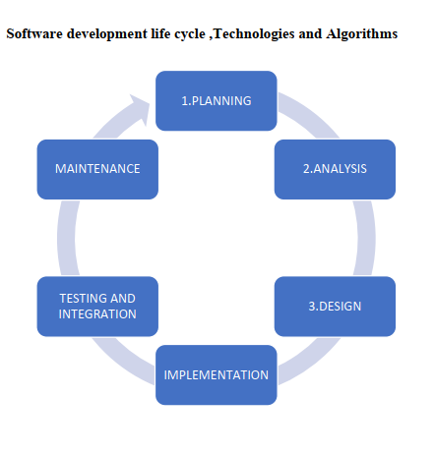


Slide 11
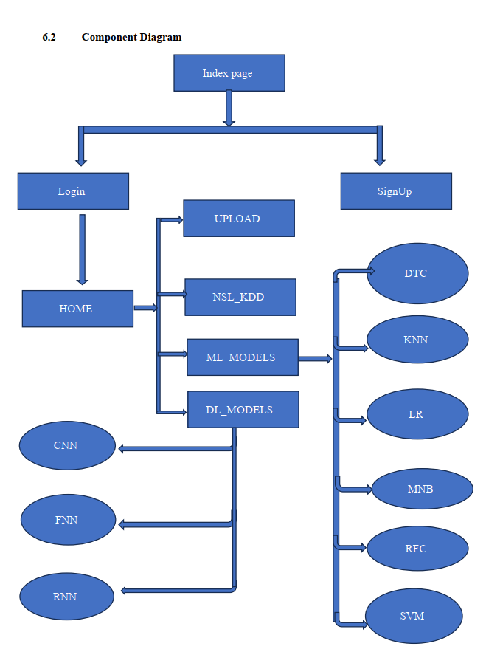

Slide 12
Data Collection and Preprocessing:
Data Collection and Preprocessing:
Gather network traffic data from various sources, such as network logs or packet capture. Preprocess the data by cleaning, normalizing, and extracting relevant features for CNN-based analysis.
DATASET
NSL_KDD DATA SET
Input Variables: 'dst_host_srv_serror_rate', 'service_ecr_i', 'flag_RSTO', 'service_urh_i', 'flag_OTH', 'dst_host_serror_rate', 'diff_srv_rate', 'dst_host_same_src_port_rate', 'serror_rate', 'flag_RSTOS0', 'wrong_fragment', 'protocol_type_icmp', 'logged_in', 'srv_serror_rate', 'dst_host_same_srv_rate', 'flag_RSTR', 'is_host_login', 'is_guest_login', 'srv_diff_host_rate', 'service_eco_i', 'flag_REJ', 'flag_S0', 'service_red_i', 'dst_host_srv_count', 'count', 'same_srv_rate', 'service_pop_3', 'protocol_type_udp', 'dst_host_srv_diff_host_rate', 'flag_SF', 'srv_count', 'dst_host_diff_srv_rate', 'flag_S3', 'num_failed_logins', 'land', 'flag_SH', 'flag_S2', 'flag_S1', 'service_urp_i', 'protocol_type_tcp', 'service_ftp'
Target Variables: 'apache2', 'back', 'buffer_overflow', 'ftp_write', 'guess_passwd','httptunnel', 'imap', 'ipsweep', 'land', 'loadmodule', 'mailbomb', 'mscan', 'multihop', 'named', 'neptune', 'nmap', 'normal', 'perl', 'phf', 'pod', 'portsweep', 'processtable', 'ps', 'rootkit', 'saint', 'satan', 'sendmail', 'smurf', 'snmpgetattack', 'snmpguess', 'spy', 'sqlattack', 'teardrop', 'udpstorm', 'warezclient', 'warezmaster', 'worm', 'xlock', 'xsnoop', 'xterm'

Slide 13
CNNs in Multiclassification of Attack Types
Feature Learning: CNNs excel at automatically learning hierarchical representations from data. In the context of NIDS, they can extract features directly from network traffic data (such as packet headers or payloads) without relying on handcrafted features.
Spatial Hierarchical Learning: CNNs process data in a spatially hierarchical manner, identifying patterns at various levels of abstraction. This makes them suitable for detecting complex patterns within network traffic that could indicate different types of attacks.
Multiclass Classification: With appropriate training, CNNs can classify network traffic into multiple attack classes. By assigning probabilities to each class, they can identify various attack types, such as DDoS attacks, SQL injection, malware traffic, etc.

Slide 14
Advantages of CNNs in Classification for NIDS:
1.Local Feature Detection: CNNs use convolutional layers that convolve learned filters across the input data, enabling them to detect local patterns regardless of their position in the input. This is crucial in NIDS, where identifying specific patterns within network traffic data is essential.
2.Translation Invariance: CNNs are robust to variations in the location of features within the input data. This means they can detect certain attack patterns even if they appear in different parts of the network traffic, enhancing their ability to generalize and detect attacks accurately.

Slide 15
Advantages of CNNs in Classification for NIDS:
3.Reduced Parameter Dependency: CNNs utilize weight sharing through convolutional filters, which reduces the number of parameters compared to fully connected networks. This helps prevent overfitting, especially in scenarios where the available labeled data for training might be limited in NIDS.
4. Adaptability to Various Data Types: CNNs can process different types of input data, whether it's raw packet data, traffic flow statistics, or other representations of network traffic. They can adapt to the characteristics of the data through appropriate preprocessing and network design.

Slide 16
CNNs in Network Intrusion Detection
1. Input Processing:
Packet Representation: CNNs can process network packets directly or after converting them into spectrograms, time-series data, or other suitable representations.
2. Convolutional Layers:
Feature Extraction: CNNs use convolutional layers to extract spatial and temporal features from network traffic.
Filters & Kernels: Filters in CNNs act as feature detectors, learning patterns at different levels of abstraction.

Slide 17
3. Pooling Layers:
Downsampling: Pooling layers reduce dimensionality, retaining important information while discarding less relevant details.
4. Fully Connected Layers:
Classification: After feature extraction, fully connected layers interpret the learned features for classification into attack types or normal behavior.

Slide 18
5.Training and Optimization:
Data Preparation: Preprocessing involves converting network data into a suitable format and labeling it according to attack types.
Training: CNNs are trained using labeled datasets, adjusting weights and biases to minimize prediction errors.
Regularization Techniques: Techniques like dropout or batch normalization can be employed to avoid overfitting.
6.Evaluation and Performance:
Metrics: NIDS performance is evaluated using metrics like accuracy, precision, recall, F1-score on a separate test dataset.
Fine-tuning: Adjustments to hyperparameters or model architecture might be necessary for optimal performance.

Slide 19
7.Challenges in NIDS with CNNs:
Imbalanced Data: Addressing imbalances where certain attack types are significantly less represented in the dataset.
Adaptability: Ensuring the model can detect new and evolving attack types.
Real-time Processing: Optimizing CNNs for efficient real-time analysis of network traffic.
8.Applications and Advantages:
CNNs offer a powerful means to automatically learn and identify complex patterns in network traffic.
Their hierarchical feature extraction capability makes them well-suited for NIDS tasks.

Slide 20
Conclusion
Implementing a Network Intrusion Detection System (NIDS) utilizing Convolutional Neural Networks (CNNs) offers a promising solution for accurate multiclassification of attack types. CNNs, renowned for their ability to autonomously learn hierarchical features from raw data, provide a robust framework for NIDS. Their capacity to detect local patterns, exhibit translation invariance, and reduce parameter dependency makes them well-suited for analyzing diverse network traffic data and identifying various attack types. By leveraging CNNs in this system, we anticipate enhanced adaptability to different data types, scalability in model architecture, and the potential to achieve accurate and efficient classification, thus fortifying network security against evolving cyber threats.

